Slide 1
Typescript in React

Slide 2
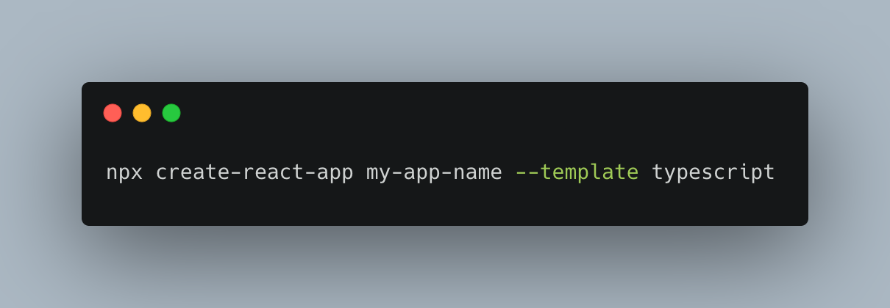
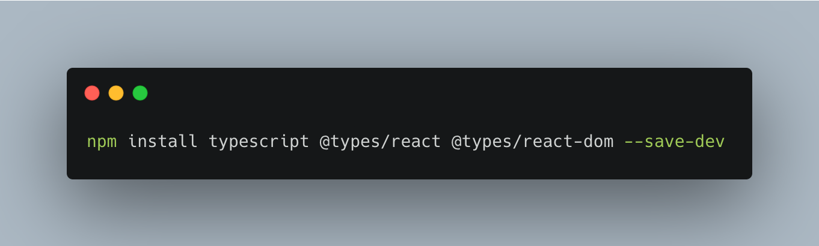
Setting up Typescript in React
Create a new React app with Typescript.
Installing Typescript in an existing React app.

Slide 3
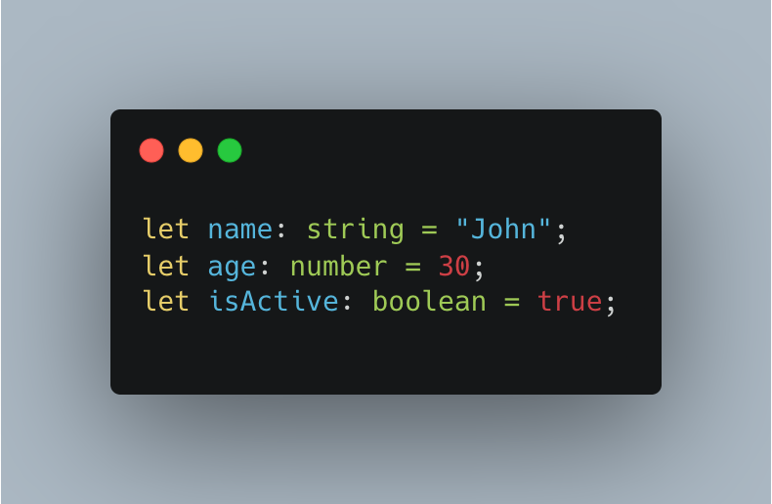
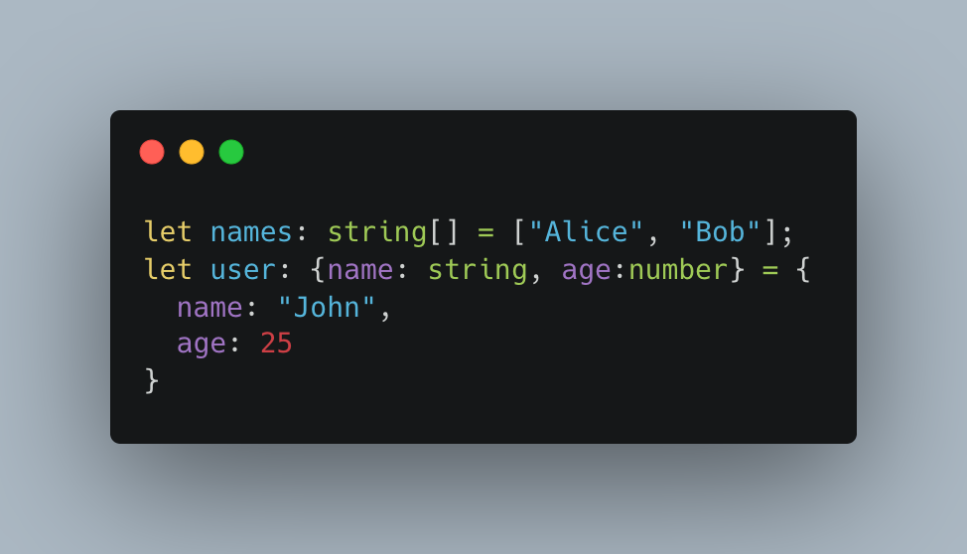
Basic Typescript Types in React
Primitive Types
Arrays and Objects

Slide 4
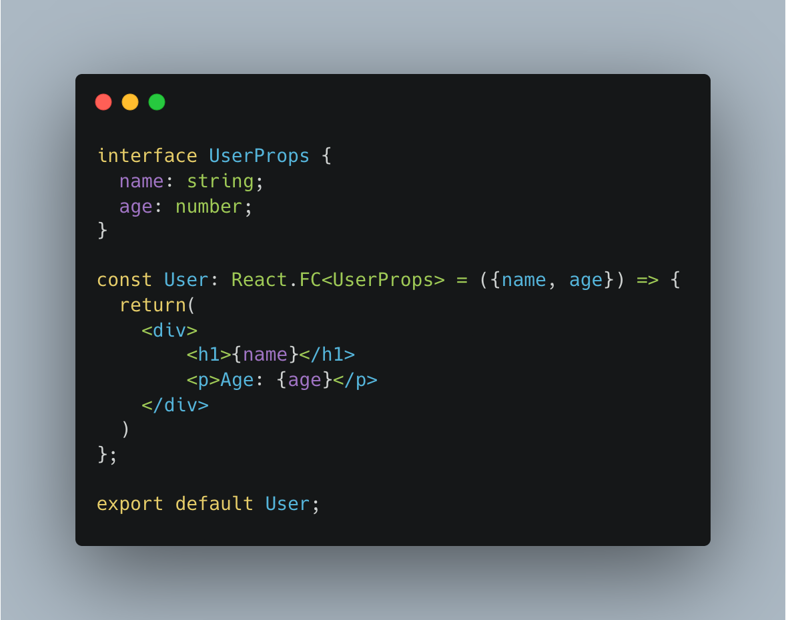
Typing Props in React Component
Using interface to define props structure.
React.FC ensures component follows functional component conventions.

Slide 5
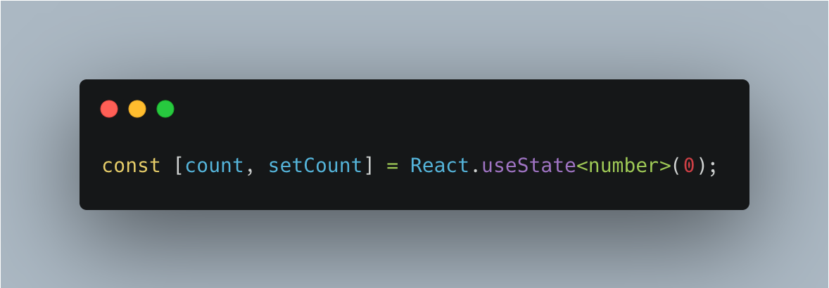
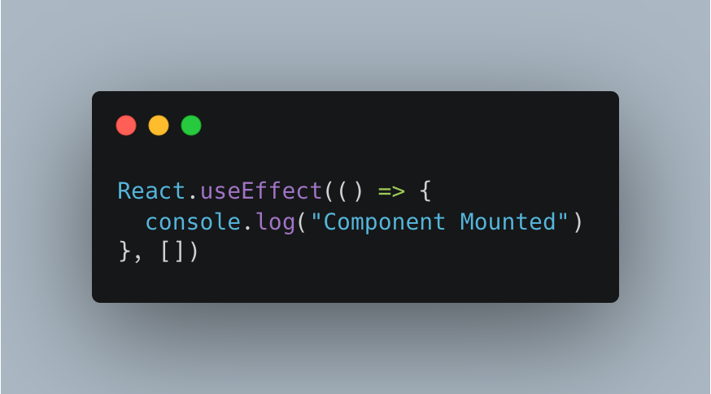
Using Typescript with React Hooks
useState Hook
useEffect Hook

Slide 6
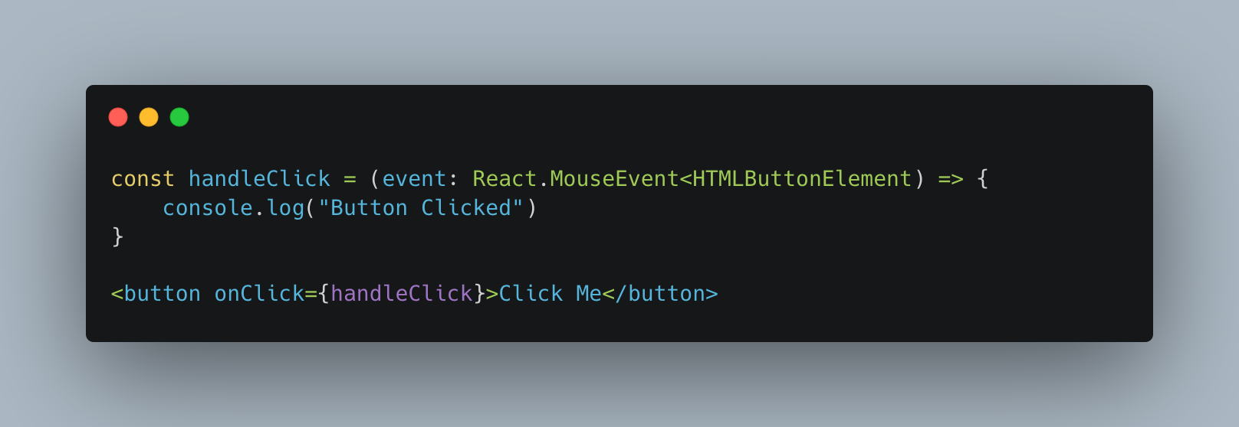
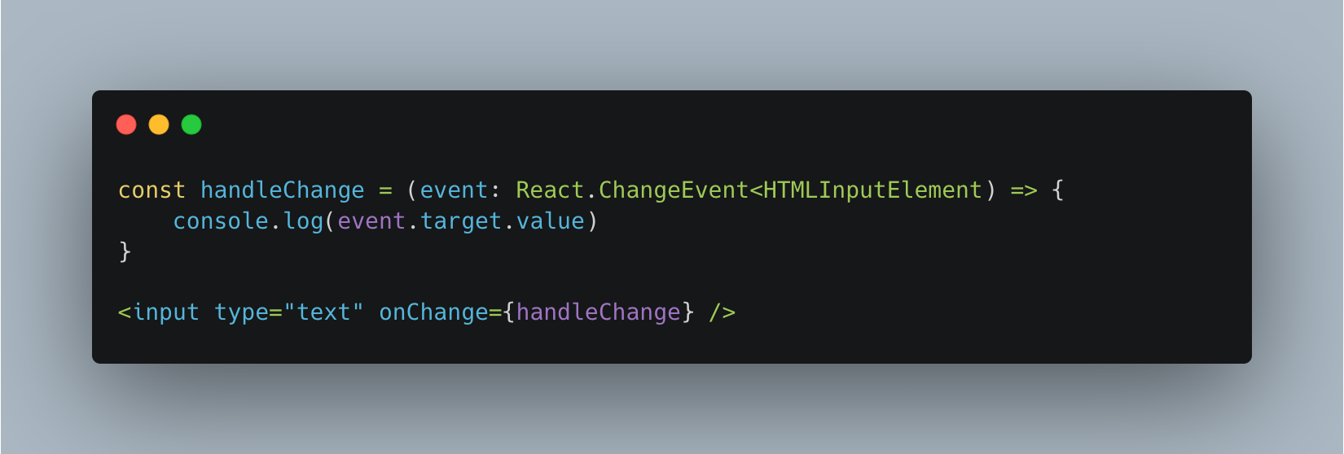
Typing Events in React
Button Click Event
Form Event

Slide 7
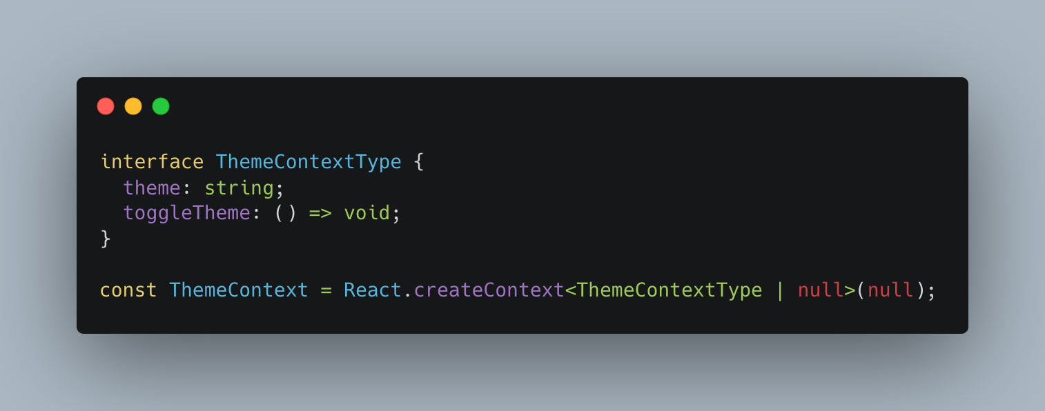
Typing Context API in React
Using createContext with Typescript for type safety.

Slide 8
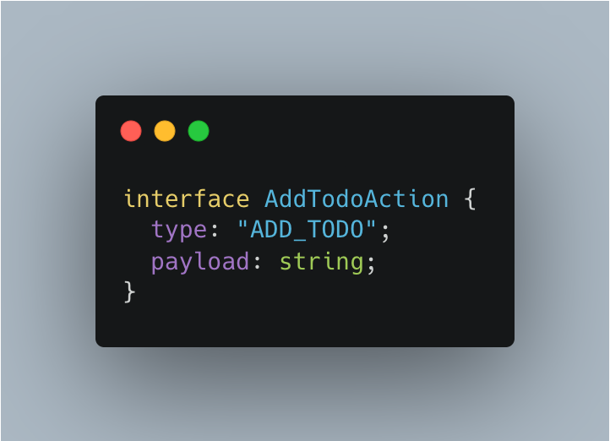
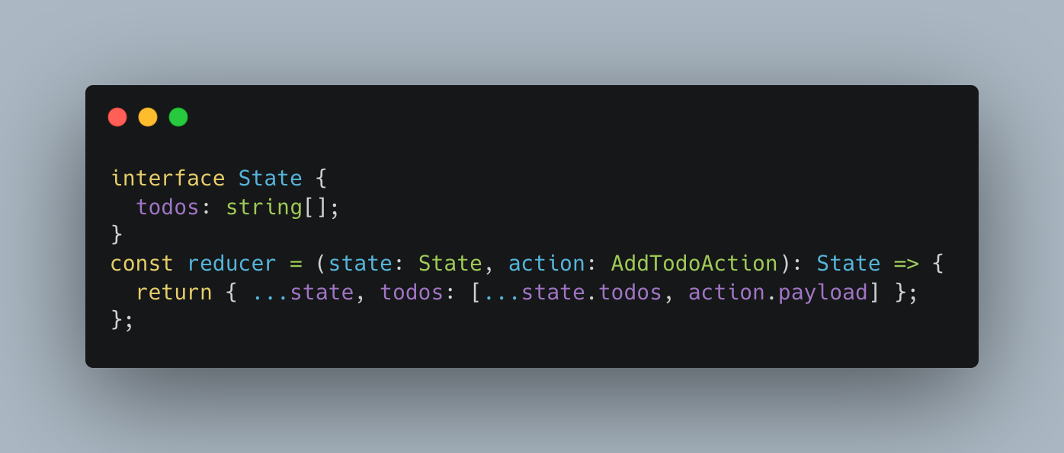
Typing Props in React Component
Redux Action
Redux Reducer

Slide 9
Learning Resources
https://react-typescript-cheatsheet.netlify.app/docs/basic/getting-started/basic_type_example/
https://github.com/typescript-cheatsheets/react

